Slide 1


Phase-2 presentation on
“Design of Wireless Electromyography (EMG) Monitoring System for Muscle Activity Detection on Parkinson Disease”
By
Hamsa N R (1RR18EC034)
Gagan N Y (1RR18EC028)
Under the Guidance of Prof. VANI S BADIGER
Assistant Professor Dept. of ECE

Slide 2
Presentation Outline
Abstract
Introduction
Literature Survey
Block diagram
Methodology
Flow chart
Hardware and software required
Advantages and Applications
Expected output
Work Done and Work to be done
References

Slide 3
ABSTRACT
Parkinson's disease attacking 1 percent of the elder population in this world, with one of the main symptoms of this disease being resting tremor.
Until now, Parkinson's disease information acquisition can only be done through patients' visits to clinics or hospitals, whereas the aspects of the disease are also shown during in-between those visits.
In this project, we develop an Electromyography (EMG) based remote-monitoring system in order for patients are able to be checked more frequently and the results are in always-renewed information.
This monitoring system utilizes Arduino IDE as the compiler component,ESP8266 WiFi module and web server. The data acquired from an arm of a tested person will always be read in real-time and can be displayed on web-based platform.
From the data acquired, they are processed in detail for pattern characteristics analysis.

Slide 4
INTRODUCTION
Parkinson’s disease (PD) is the most common neuro generative disease after Alzheimer and it is attacking 1% of the elderly population of above 65 years old in the world.
Nerve cell damage in the brain causes dopamine levels to drop leading to the symptoms of the Parkinson’s.
With the presence of bio potential technology, the muscle activity pattern of Parkinson’s patients can be checked and recorded using electromyography (EMG) techniques.
Parkinson's disease symptoms can appear to be mild and grow over time. Affected individuals may experience slight tremors or difficulty in getting out of a couch, for example.
Detecting and monitoring the motor symptoms plays an important role in early detection of the disease and helps doctors perform early diagnosis.
We aim to detect PD using a multi-symptom approach that evaluates passively captured data from multiple sensors.

Slide 5
Literature Survey
SL No. | Title of the Paper. | Journal and publishing year. | Authors. | Methodology. | Limitations.
1. | A Hybrid Approach to Parkinson Disease Classification using speech signal. | IEEE, 2018. | Kemal Polat. | This method used multiple voice features for effective detection. This method used patient’s speech variations to detect PD. | Background Noise Interference.
2. | Sensor based Detection of Parkinson’s Disease Motor Symptoms. | IEEE, 2020. | Vinayak Majhi, Sudip Paul, Goutam Saha, Jitendra Kumar Verma | Inertial Measurement Unit (IMU) is used as a complete sensor for measuring tremor. | They are prone to error that accumulates over time, also known as drift.

Slide 6
SL No. | Title of the Paper. | Journal and publishing year. | Authors. | Methodology. | Limitations.
3. | A System to Monitor Tremors in Patients with Parkinson's Disease . | IEEE, 2018. | A. Bermeo, Student Member, IEEE, M. Bravo, Student Member, IEEE, M. Huerta, Senior Member, IEEE and A. Soto, Member, IEEE. | The signals acquisition in the extremities of the PD patient is performed by the Tremors Sensor Device; this device sends the acquired data toward Examiner android phone. | The sensor has an internally fixed range and time , potentially limiting their uses in some applications.
4. | Hand Movement Compensation for Patients with Parkinson’s Disease Based on Polar Coordination System with Varied Origin | IEEE, 2018. | Min Wang1 , Bei Wang , Junzhong Zou , Jian Zhang , Masatoshi Nakamura. | Spiral drawing experiment is a task which involves fine accurate continuous movements. The recording data reflect the patients’ own hand movement ability. | This exercise can cause fatigue.

Slide 7
SL No. | Title of the Paper. | Journal and publishing year. | Authors. | Methodology. | Limitations.
5. | Identifying Fine Movement Difficulties in Parkinson's Disease Using a Computer Assessment Tool. | IEEE, 2020. | L. Cunningham, C. Nugent, G. Moore, D. Finlay, and D. Craig. | This assessment tool collects data on the user's mouse movements by asking them to click targets on screen. | This method cannot be used for all people since speed of movement of mouse varies with the individual.
6. | Analysis of Tremors in Parkinson’s Disease Using Accelerometer. | IEEE, 2021. | Niya Romy Markose, Priscilla Dinkar Moyya , Mythili Asaithambi. | Accelerometer sensor which measures the motion and a processor that converts the signals observable in the personal computer. | This disease has multiple symptoms but this paper deals with only one symptom.

Slide 8
SL No. | Title of the Paper. | Journal and publishing year. | Authors. | Methodology. | Limitations.
7. | A Study on Gait-based Parkinson’s Disease Detection Using a Force Sensitive Platform | IEEE, 2018. | Xi Wu1 , Xu Chen , You Duan , Shengqiang Xu , Nan Cheng , Ning An | The self-developed gait sensing platform is a u-shape electronic walkway that consists of flexible force sensitive pressure sensors. It is comprised of 14 pressure pads, extracts a variety of temporal and spatial gait parameters. | This method uses 14 pressure pads which is difficult to insert on an elderly patient. It is also expensive since it uses more number of sensors.
8. | Ambulatory Monitoring of Physical Activities in Patients With Parkinson’s Disease. | IEEE, 2019. | Arash Salarian, Member, Heike Russmann, François J. G. Vingerhoets, Pierre R. Burkhard, and Kamiar Aminian. | Accelerometer measuring trunk accelerations in the frontal direction. gyroscope measuring the angular velocity in the sagittal plane. | This method is less accurate since it relays on velocity of the patient.

Slide 9
SL No. | Title of the Paper. | Journal and publishing year. | Authors. | Methodology. | Limitations.
9. | Monitoring of motor and non-motor symptoms of Parkinson’s disease through a mHealth platform. | IEEE, 2019. | Jorge Cancela, Samanta Villanueva Mascato, Dimitrios Gatsios, George Rigas, Andrea Marcante, Giovanni Gentile, Roberta Biundo. | Two sensors, a smartphone in the pocket and one wristband are used. The insole sensor and the measurements are stored in the embedded memory. The collected raw data from the wristband is stored in the smartphone memory. | The sensors are affected by the movement. Tapping of legs can cause variations.
10. | Building a Machine-Learning Framework to Remotely Assess Parkinson's Disease Using Smartphones. | IEEE, 2018. | Oliver Y. Chen, Florian Lipsmeier, Huy Phan, John Prince, ´ Kirsten I. Taylor, Christian Gossens, Michael Lindemann, and Maarten de Vos. | The work proposed used ANN.This was used to recognize the patient’s movement and muscle activity. | The training dataset may contain errors, which might affect the final output.

Slide 10
EXISTING PROBLEM
In existing system, PD is detected at the secondary stage only (Dopamine deficiency) which leads to medical challenges.
Thus, the mental disorders are been poorly characterized and have many health complications. PD is generally diagnosed with the following clinical methods as,
MRI or CT scan - Conventional MRI cannot detect early signs of Parkinson's disease
PET scan - is used to assess activity and function of brain regions involved in movement
SPECT scan - can reveal changes in brain chemistry, such as a decrease in dopamine
This results in a high misdiagnosis rate (up to 25% by non-specialists) and many years before diagnosis, people can have the disease. Thus existing system is not effective in early prediction and accurate medicinal diagnosis to the affected people.

Slide 11
PROPOSED SOLUTION
Automatic evaluation of PD symptoms using wearable accelerometers, inertial, and electromyography sensors has been proposed as a way to overcome the limitations faced in previous methods.
The device is developed to detect PD using a multi-symptom approach that merges passively-captured data from different sensors.
Wearable sensors are fundamental in helping clinicians perform early diagnosis, differential diagnosis, and objective quantification of symptoms over time.
To reduce the burden of caretakers, The wearable device can measure tilt and fall of the homebound patients and can send a notification via smartphone to the caregivers if a critical situation is occurring. Such a system would enable remote assistance.

Slide 12
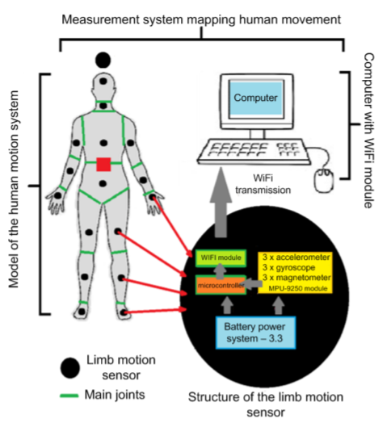
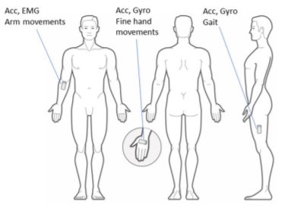
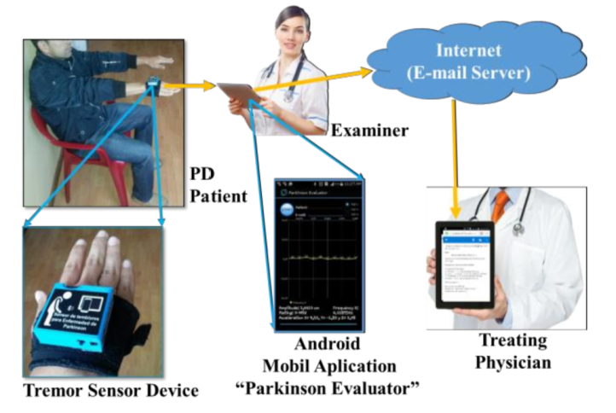
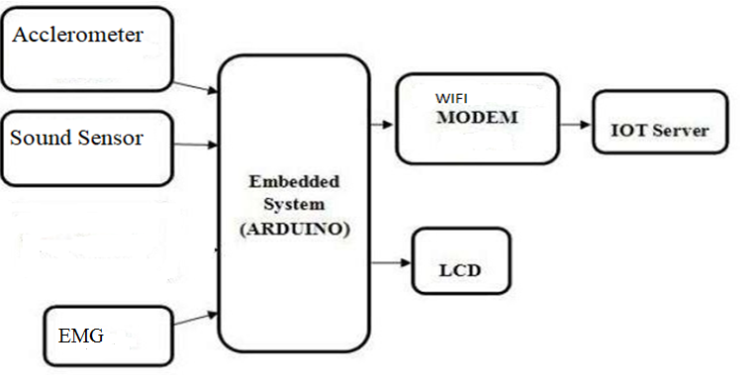
BLOCK DIAGRAM

Slide 13
METHODOLOGY
First the person is made to do some simple exercises. These exercises include body movement exercises, speaking exercise, writing, running and walking.
The accelerometer is used to measure tremors and the data is sent to the microcontroller. Tremor is the involuntary shaking of body parts, and it is one of the most observable symptoms.
Sound sensor is used for automatic classification of Parkinson’s disease (PD) speakers and healthy controls (HC) is performed considering speech recordings collected in non-controlled noise conditions.
Accelerometer sensors are embedded in the device to get the result of fall detection more accurately.
EMG Sensor is used to measure small electrical signals generated by our muscles when you move them. This includes lifting your arm up or clenching your fist.
All the data collected from these sensors are sent to the microcontroller for determining whether the person has Parkinson’s disease or not.
The sensor values are monitored by the microcontroller. If the sensor values exceeds the threshold values, then the information is sent to the doctors and respective caretakers.
The device is integrated with IoT framework for patient monitoring, storage of sensor values and cloud access by caregiver for further treatment.

Slide 14
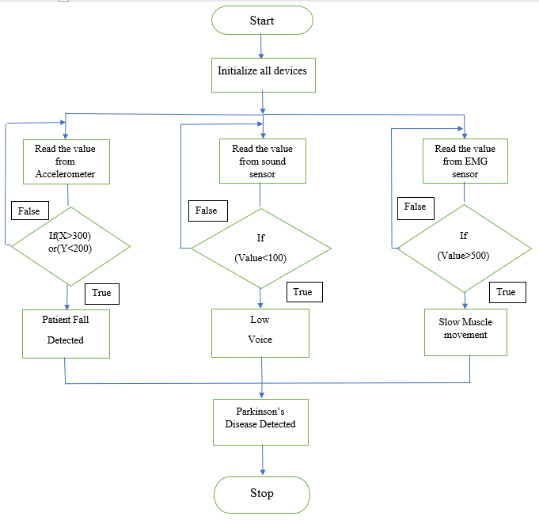
FLOW CHART
parkinsonc.txt

Slide 15
HARDWARE AND SOFTWARE REQUIRED
Hardware Requirements:
Arduino Uno
LCD Display
Accelerometer
EMG Sensor
Sound Sensor
Wi-Fi
Software Requirements:
Arduino IDE
Embedded C

Slide 16
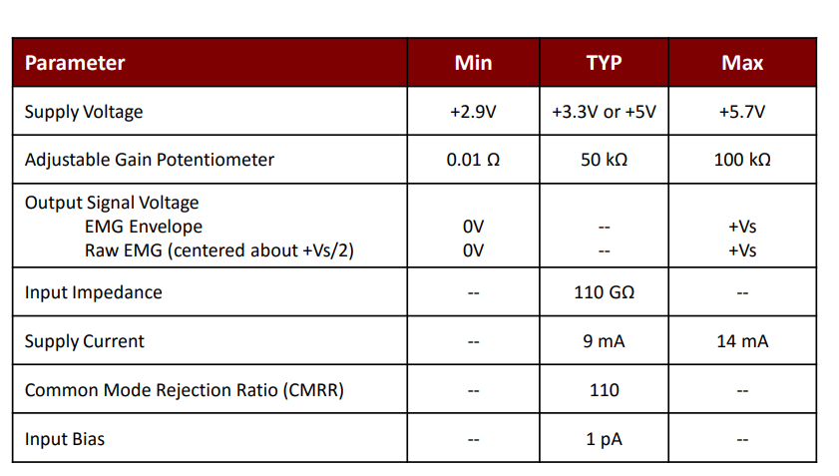
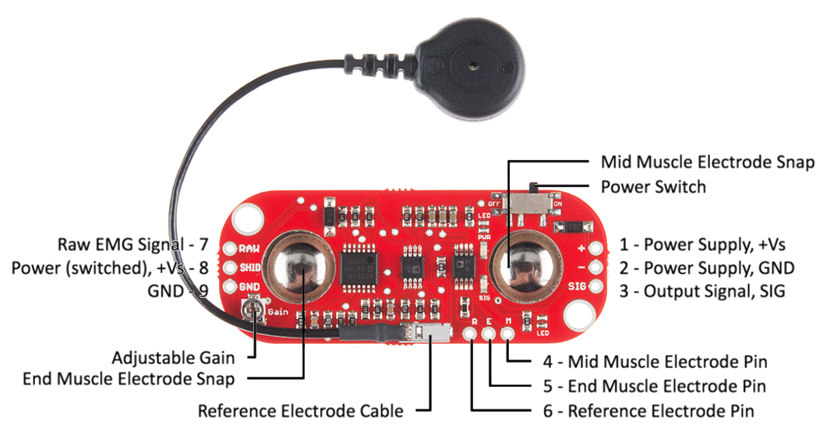
EMG SENSOR

Slide 17
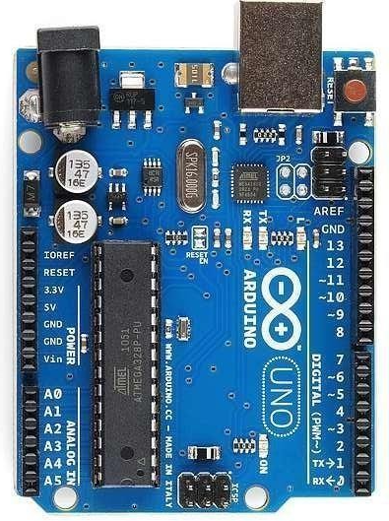
ARDUINO UNO
Specification:
Microcontroller ATmega328
Operating Voltage 5V
Input Voltage (recommended) 7-12V
Input Voltage (limits) 6-20V
Digital I/O Pins 14 (of which 6 provide PWM output)
Analog Input Pins 6
DC Current per I/O Pin 40 mA
DC Current for 3.3V Pin 50 mA
Flash Memory 32 KB (ATmega328) of which 0.5 KB used by bootloader
SRAM 2 KB (ATmega328)
EEPROM 1 KB (ATmega328)
Clock Speed 16 MHz

Slide 18
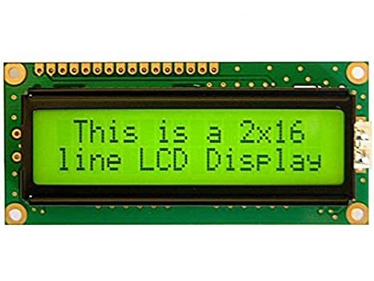
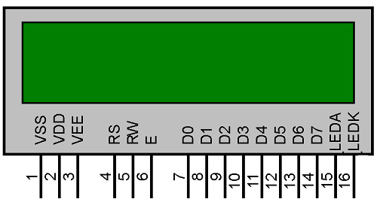
LCD MODULE
Specifications:
The operating voltage of this display ranges from 4.7V to 5.3V
The display bezel is 72 x 25mm
The operating current is 1mA without a backlight
PCB size of the module is 80L x 36W x 10H mm
HD47780 controller
LED color for backlight is green
Number of columns – 16
Number of rows – 2
Number of LCD pins – 16
Characters – 32
It works in 4-bit and 8-bit modes
Pixel box of each character is 5×8 pixel
Font size of character is 0.125Width x 0.200height

Slide 19
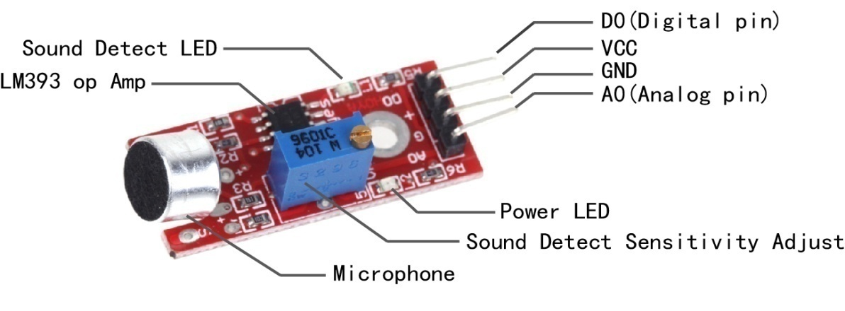
SOUND SENSOR
Specifications:
Working voltage: 1.6-3.6V
Current consumption : 650 µA
Turn-on time: 10 ms
Duty cycle: min = 40% max = 60%
Signal-to-noise ratio : 64dB(A)
Input clock frequency: 2.4 MHz

Slide 20
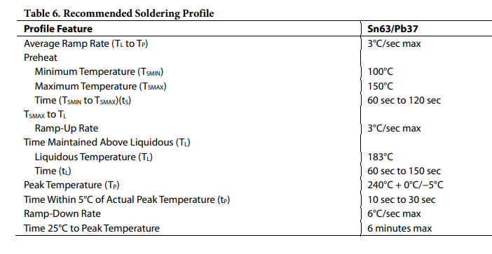
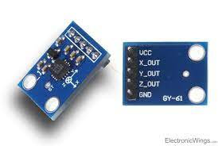
ACCELEROMETER
Specifications:

Slide 21
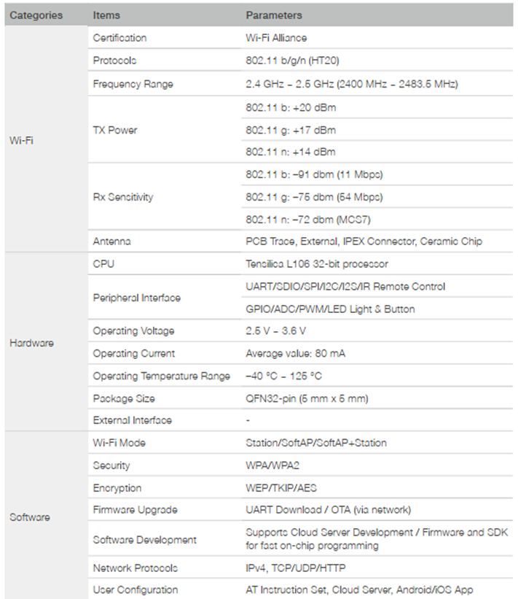
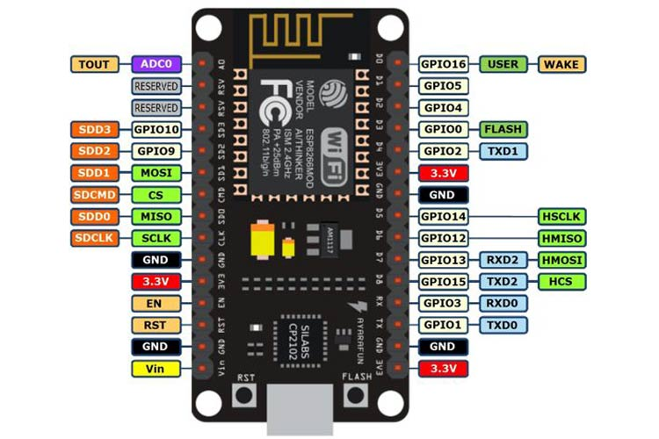
Wi-Fi MODULE

Slide 22
SOFTWARE REQUIREMENTS
Arduino complier: The Arduino Integrated Development Environment is a cross-platform application that is written in functions from C and C++. It is used to write and upload programs to Arduino compatible boards, but also, with the help of third-party cores, other vendor development boards.
MC Programming language C- C Language is developed by Dennis Ritchie for creating system applications that directly interact with the hardware devices such as drivers, kernels, etc.

Slide 23
Advantages and Applications:
ADVANTAGES
Automated Process
Portable Device
Cost Effective
Automated Intimation
APPLICATIONS
Used to detect Parkinson’s Disease at early stage.
Used to detect neurodegenerative disorders.
Used for clinical diagnosis for patients above 50 years.

Slide 24
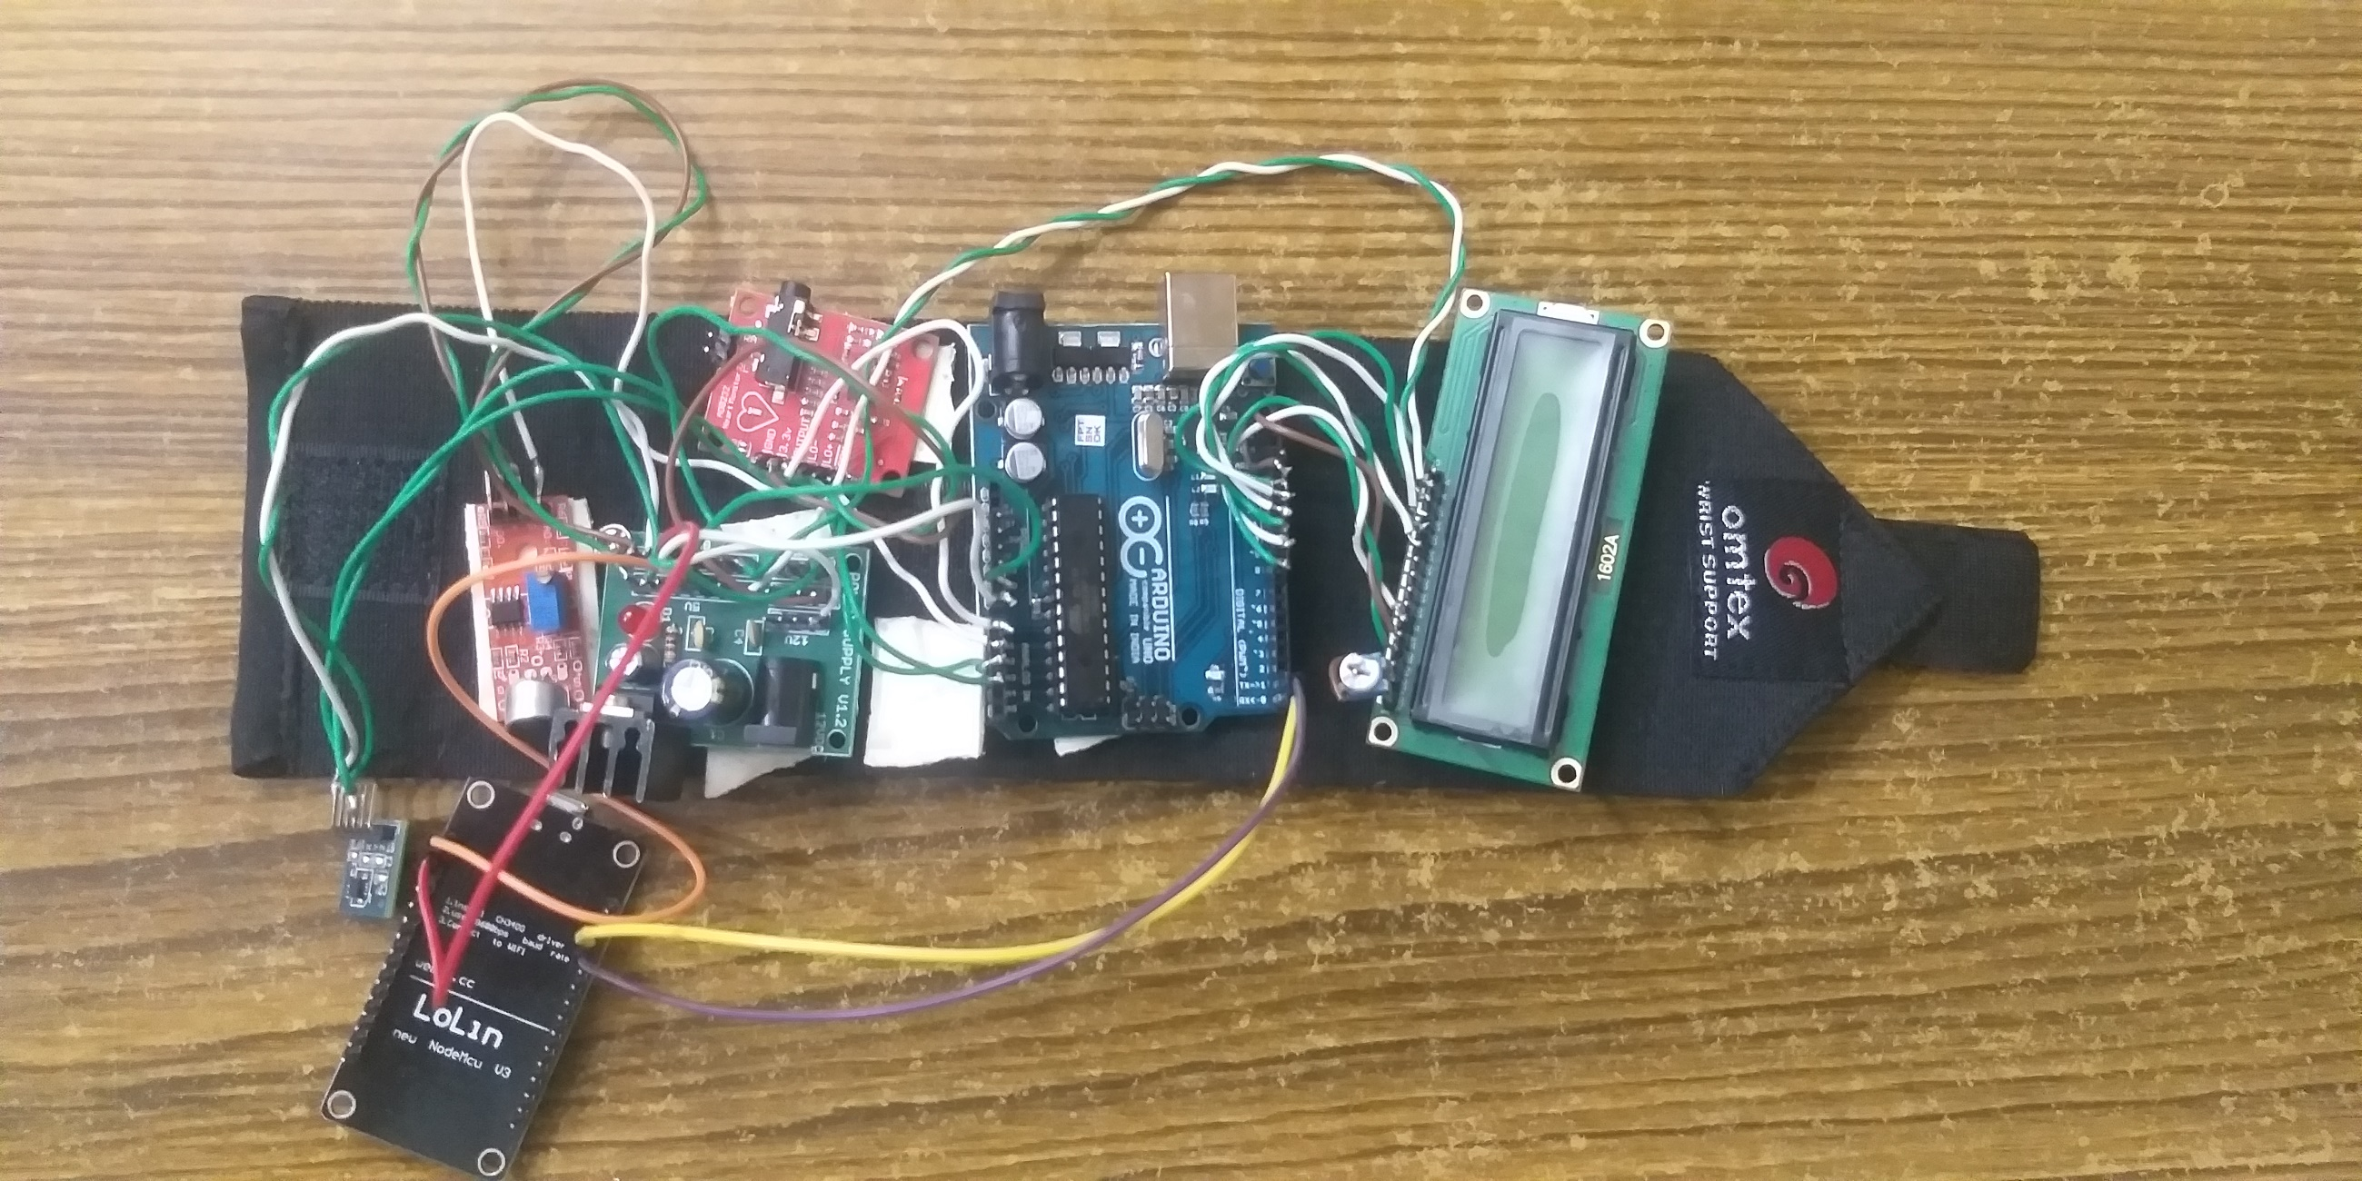
RESULT:

Slide 25
Expected Output
Automated Emergency Situation Detection.
Monitoring Person conditions.
Intimation Alert to Care Takers.
Early detection of Parkinson’s Disease

Slide 26
REFERENCES
[1] C.M. Tanner and S.M. Goldman, ”EPIDEMIOLOGY OF PARKINSON’S DISEASE,”Neurologic Clinics, vol. 14, no. 2, pp. 317-335, 1996.
[2] J.J. Pasternak and W.L. Lanier, ”Diseases Affecting the Brain: Parkinson's Disease,” in Stoelting's Anesthesia and Co-Existing Disease, Elsevier, Inc, 2018, pp. 265-303.
[3] L.V. Kalia and A.E. Lang, ”Parkinson’s disease,” The Lancet, vol. 386, pp. 896-912, 2015.
[4] J.A. Stamford, P.N. Schmidt and K.E. Friedl, ”What Engineering Technology Could Do for Quality of Life in Parkinson’s Disease: A Review of Current Needs and Opportunities,”IEEE Journal of Biomedical and Health Informatics, vol. 19, no. 6, pp. 1862-1872, 2015.
[5] C. Fazekas, T. Vörös, Z. Keresztényi, G. Kozmann, J Laczkó,”Computer aided interactive remote diagnosis of Parkinsonians,”Stud Health Technol Inform, vol. 90, pp. 572-576, 2002.
[6] D. Giansanti, V. Macellari and G. Maccioni, ”Telemonitoring and Telerehabilitation of Patients with Parkinson’s Disease: Health Technology Assessment of a Novel Wearable Step Counter,”Telemedicine and e-Health, vol. 14, no. 1, pp. 76-83, 2008.

